Slide 1
Natural Language Processing

Slide 2
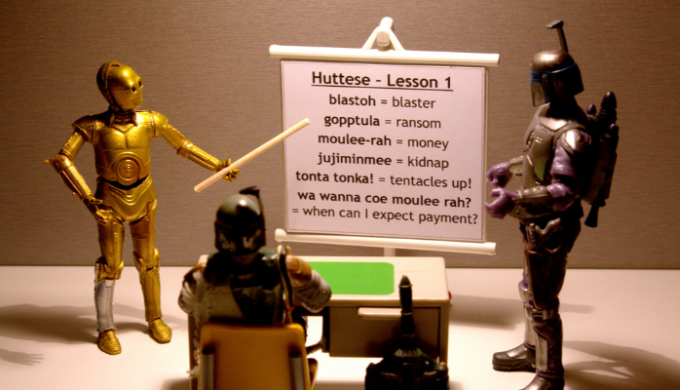
What is Natural Language Processing (NLP)
It is a field of Artificial Intelligence that gives machines the ability to read, understand and derive meaning from human languages.

Slide 3
NLP – What’s the problem?
Everything we express (verbally or written) has lots of information (topic, tone, words…).
This information can be interpreted, and value extracted from it.
In theory, we can understand and even predict human behaviour using that information.
However, each sentence comes with its complexity.
If you want to scale and analyze several hundreds, thousands or millions of text data, then the situation is unmanageable.
Data generated from conversations, declarations or even tweets are examples of unstructured data.

Slide 4

NLP – What’s the Problem…
Unstructured data doesn’t fit neatly into the traditional row and column structure of relational databases
Unfortunately, it represents vast majority of data available in the actual world (as much as 90 percent, according to Forbes).
It is messy and hard to manipulate
Fortunately, with NLP & ML, a big revolution is going on regarding this topic.

Slide 5
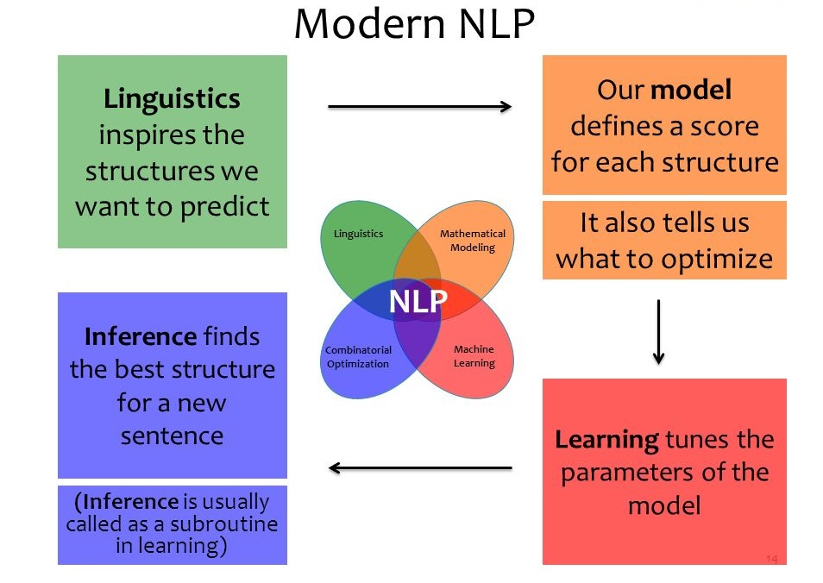
Modern NLP
Today, it is no longer about trying to interpret a text or speech based on its keywords (the old fashioned mechanical way), but about understanding the meaning behind those words (the cognitive way). This way it is possible to detect figures of speech like irony, or even perform sentiment analysis.

Slide 6
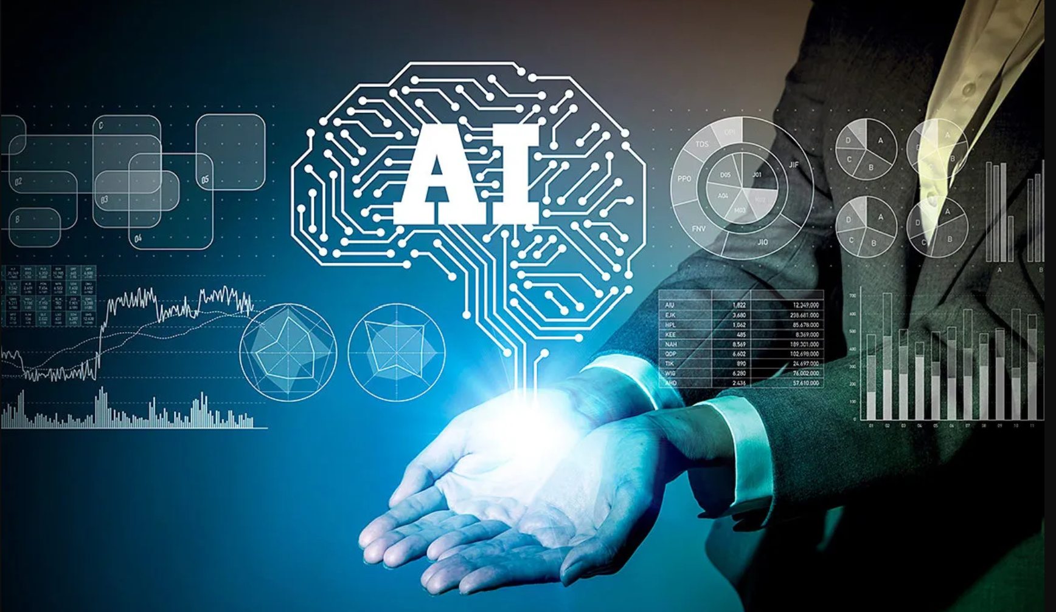
NLP Today
Machine Translation
Prediction of diseases
Sentiment Analysis
Question-Answering Systems
Cognitive Assistant
Summarizing Documents
Topic Modelling
E-mail Spam Detection
Identifying Fake News
Voice Driven Interfaces
Talent Recruitment
Speech to sign language
Closed captioning – automatically
Lip reader technology
Sarcasm detection

Slide 7
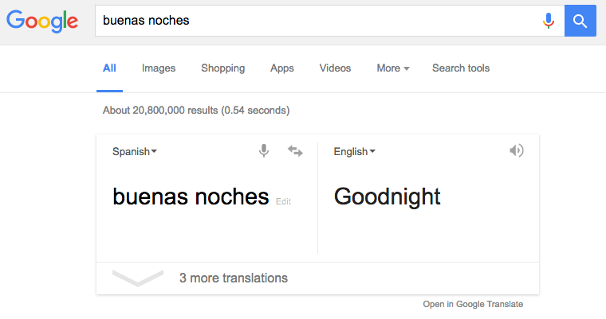
Machine Translation

Slide 8
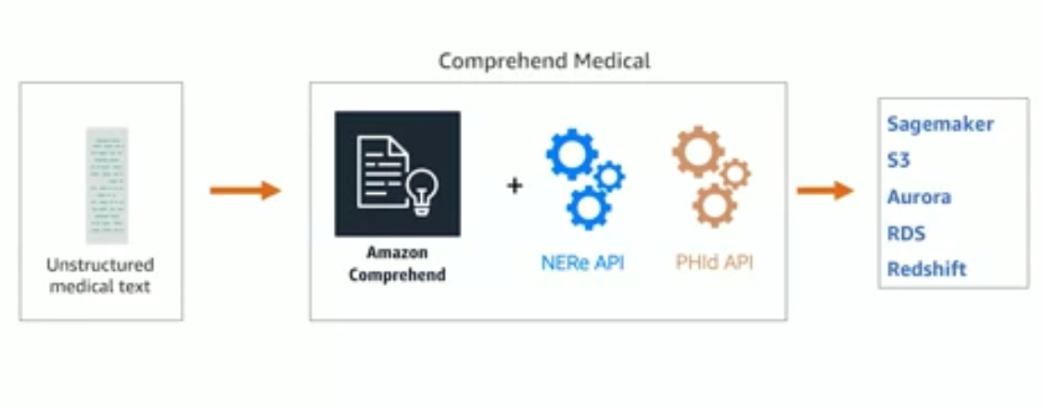
Prediction of Diseases
Amazon Comprehend Medical
Notes:
Amazon Comprehend Medical is a natural language processing service that makes it easy to use machine learning to extract relevant medical information from unstructured text. Using Amazon Comprehend Medical, you can quickly and accurately gather information, such as medical condition, medication, dosage, strength, and frequency from a variety of sources like doctors’ notes, clinical trial reports, and patient health records. Amazon Comprehend Medical can also link the detected information to medical ontologies such as ICD-10-CM or RxNorm so it can be used easily by downstream healthcare applications.
Does Named Entity extraction for medical text such as clinical notes, clinical reports, patient health records.
Also does Entity Relationships to extract useful information and link to medical ontologies for use by downstream healthcare applications.

Slide 9

Sentiment Analysis
Sentiment Analysis - is the most common text classification tool that analyses an incoming message and tells whether the underlying sentiment is positive, negative our neutral.
Intent Analysis - steps up the game by analyzing the user’s intention behind a message and identifying whether it relates an opinion, news, marketing, complaint, suggestion, appreciation or query.

Slide 10
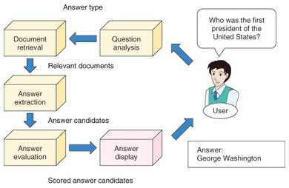
Question Answering Systems

Slide 11
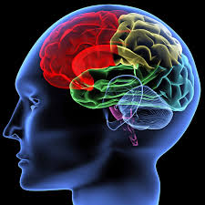
Cognitive Assistants
An inventor at IBM developed a cognitive assistant that works like a personalized search engine by learning all about you and then remind you of a name, a song, or anything you can’t remember the moment you need it to.

Slide 12
Summarizing Documents
Summarization is the task of condensing a piece of text to a shorter version, reducing the size of the initial text while at the same time preserving key informational elements and the meaning of content.
Comes in two flavours:
Extractive - picks up sentences directly from the document based on a scoring function to form a coherent summary.
Abstractive - aim at producing summary by interpreting the text using advanced natural language techniques in order to generate a new shorter text.
Notes:
Abstractive methods take advantage of recent developments in deep learning. Since it can be regarded as a sequence mapping task where the source text should be mapped to the target summary, abstractive methods take advantage of the recent success of the sequence to sequence models.

Slide 13
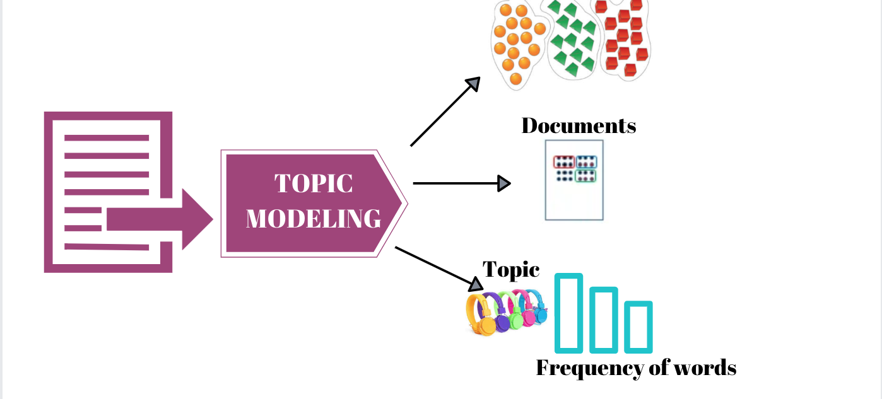
Topic Modelling

Slide 14
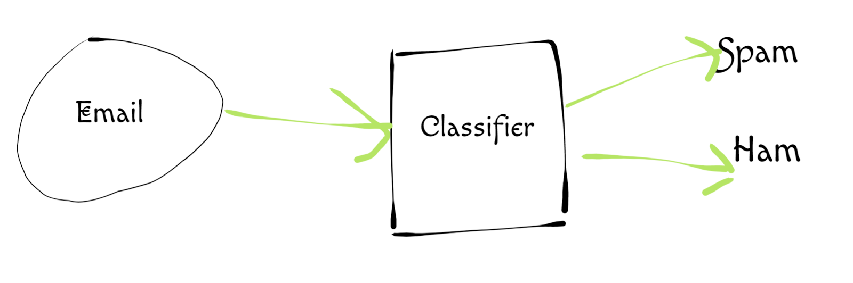
E-mail Spam Detection

Slide 15

Fake News Detection

Slide 16
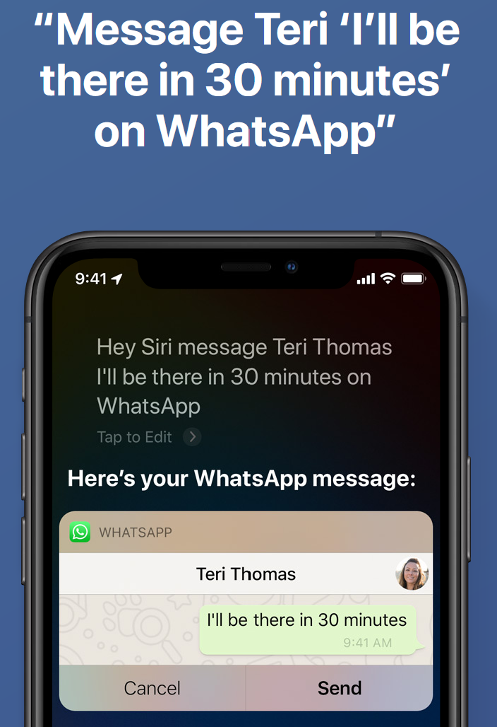
Voice Driven Interfaces
Voice user interfaces (VUIs) allow the user to interact with a system through voice or speech commands.
Examples Include:
Siri
Cortana
Alexa

Slide 17
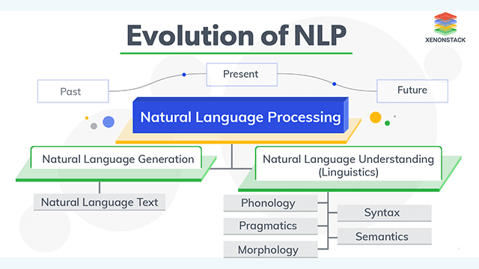
Natural Language Understanding
“The comprehension by computers of the structure and meaning of human language, allowing users to interact with the computer using natural sentences.” Gartner.

Slide 18
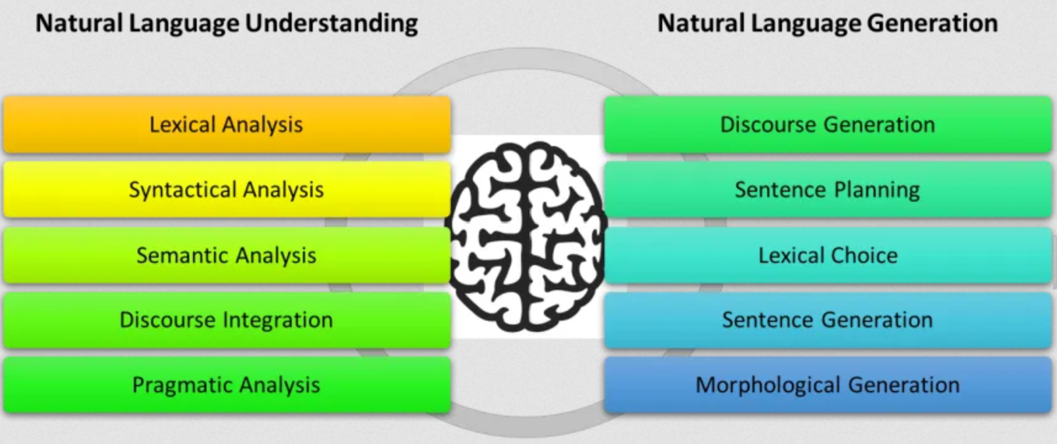
NLU and NLG

Slide 19

Challenges in NLP

Slide 20
1. Natural Language Understanding
“None of our models exhibit real understanding of natural language”. Sebastian Ruder, 2019
Develop systems that read and understand text like humans, by forming a representation of the world of the text, with the agents, objects, settings, and the relationships, goals, desires, and beliefs of the agents, and everything else that humans create to understand a piece of text.
Issues still unresolved include: -
Finding the meaning of a word or a word sense
Determining scopes of quantifiers
Finding referents of anaphora
Relation of modifiers to nouns
Identifying the meaning of tenses to temporal objects
Notes:
Examples of Anaphora
I’m sick and tired of you letting me down. I’m sick and tired of you making me mad. And I’m sick and tired of you doing such silly things!

Slide 21
2. Innate biases vs learning from scratch
Design systems that can learn more from less data – at a higher level of abstraction, compared to those without structure.
Issues: -
Imposing structure makes certain assumptions, which may be invariably wrong for at least some of the data.
In practice it’s difficult to make the correct structural assumptions, and those assumptions don’t always translate to comprehensive performance gains.
On the other hand, If you have access to huge amounts of data and computation, he argued, you can succeed by building simple but inefficient systems that perform “glorified nearest neighbor learning” at a superficial level
Notes:
Solution: Impose the right kind of innate structure, that enables systems to learn concepts efficiently at the right level of abstraction.

Slide 22
3. NLP for low resource scenarios
Universal language model
Cross-lingual representations
Incentives and skills for low resource languages

Slide 23
4. Reasoning about large or multiple documents
Our current models are mostly based on recurrent neural networks, which cannot represent longer contexts well.
“The stream of work on graph-inspired RNNs is potentially promising, though has only seen modest improvements and has not been widely adopted due to them being much less straight-forward to train than a vanilla RNN.” Isabelle Augenstein.
Notes:
A more useful direction thus seems to be to develop methods that can represent context more effectively and are better able to keep track of relevant information while reading a document. Multi-document summarization and multi-document question answering are steps in this direction. Similarly, we can build on language models with improved memory and lifelong learning capabilities.

Slide 24
5. Datasets, problems, and evaluation
Perhaps the biggest problem is to properly define the problems themselves. And by properly defining a problem, I mean building datasets and evaluation procedures that are appropriate to measure our progress towards concrete goals.

Slide 25
NLP Methods

Slide 26
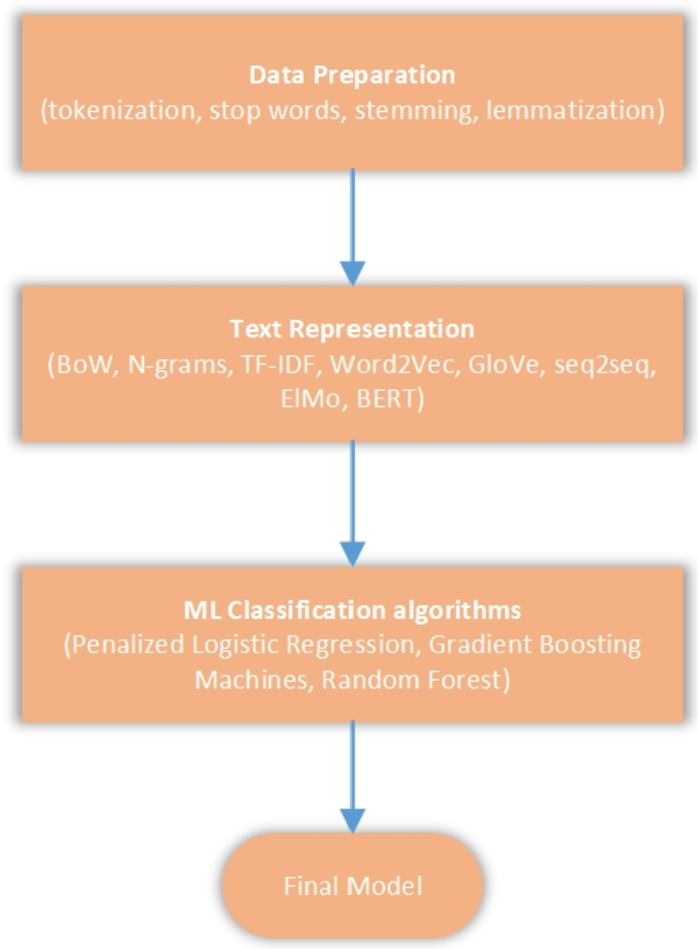
High Level Process Flow

Slide 27
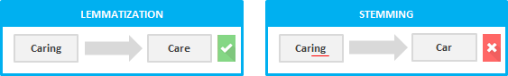
Data Preparation
Tokenization - the process of chopping of sentences into pieces called tokens and, in the process, throwing away unwanted characters.
Stopword removal - the process of removing stop words from the sentences such as: articles, prepositions, punctuation marks.
Stemming - The process of slicing the end or the beginning of words with the intention of removing affixes (lexical additions to the root of the word).
Lemmatization - Has the objective of reducing a word to its base form and grouping together different forms of the same word.

Slide 28
Text Representation
Summarization Techniques
Bag of Words
N-grams
TF-IDF
Neural Network Language Models
Word2Vec/Doc2Vec
Fast Text
GloVe
Sequence to Sequence Models
Transformers
Bidirectional Encoder Representations from Transformer

Slide 29
Challenges with Summarization Techniques
BoW – does not have word ordering, hence looses contextual meaning of words during representation.
N-grams – They cannot maintain long word dependencies in sentences.
TF-IDF – Makes assumption that rare words in the document are more important.

Slide 30
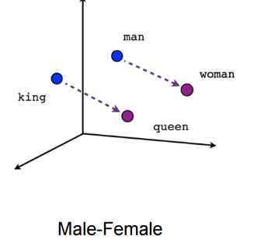
Word2Vec Model
Uses a neural network model to learn word associations from a large corpus of text.
Representations are created using 2 algorithms:-
Continuous Bag of Words
Skip-gram
Such representations, encapsulate different relations between words, like synonyms, antonyms, or analogies

Slide 31
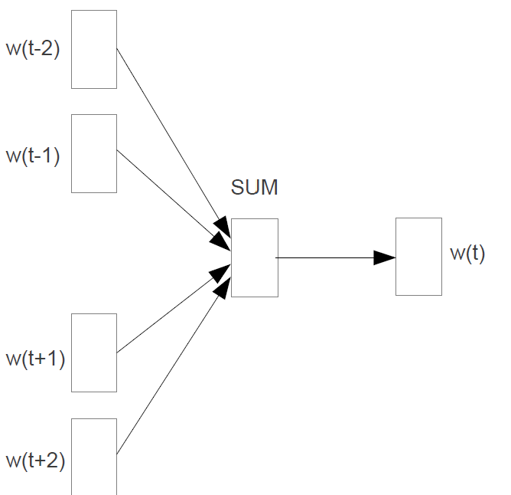
Continuous Bag of Words
Predict the target word using context words on both sides of the sentence.
Each word is represented as a feature vector.
After training, these vectors become the word vectors.

Slide 32
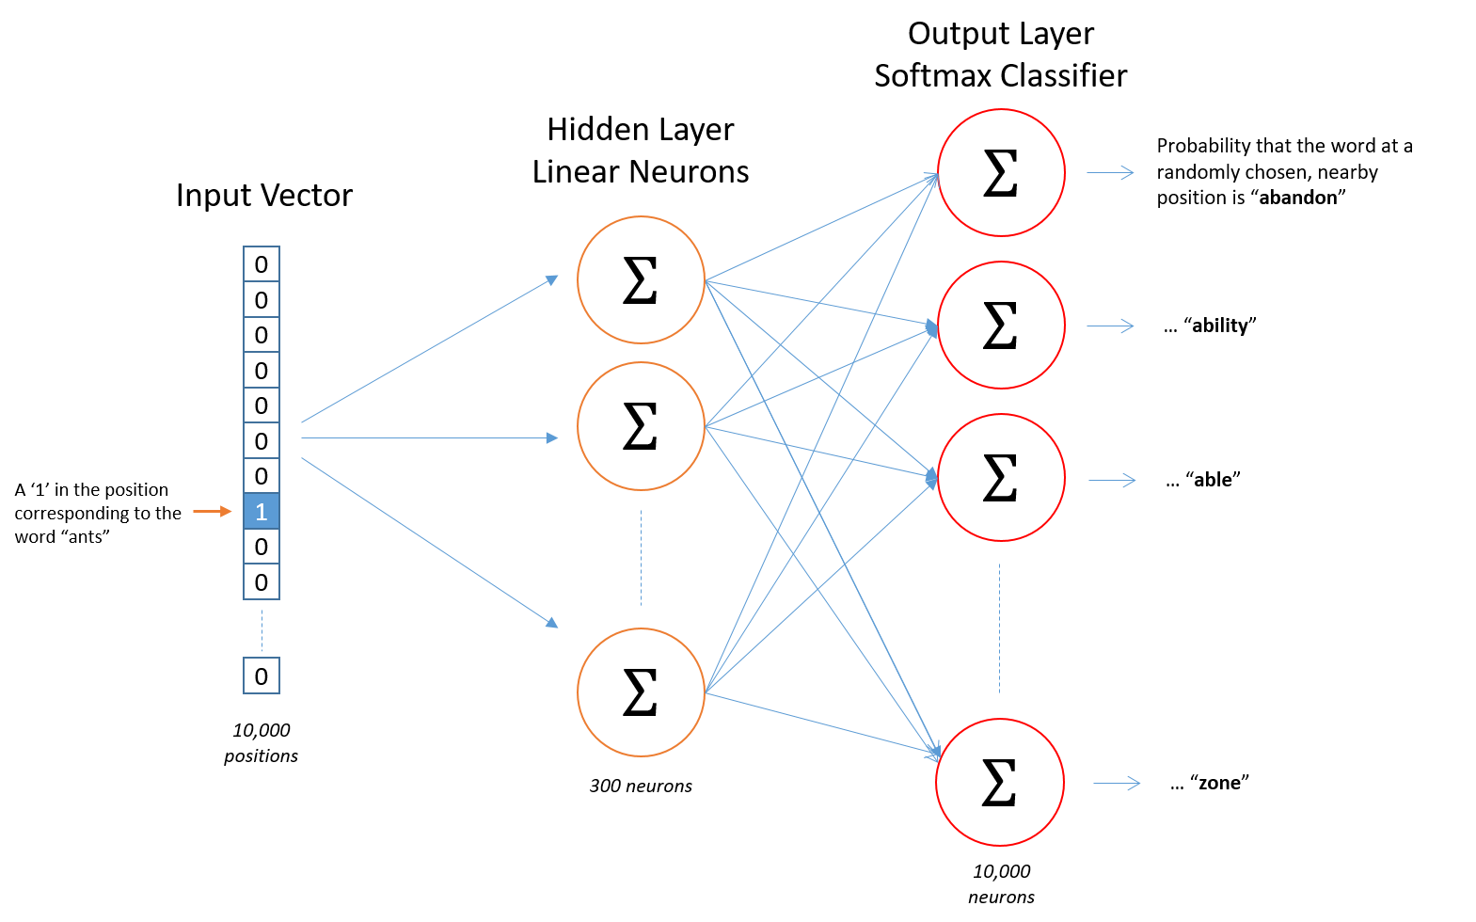
Skip-gram Model
Skip-gram model uses a given word to predict likelihood of the closest words next to it (context).

Slide 33
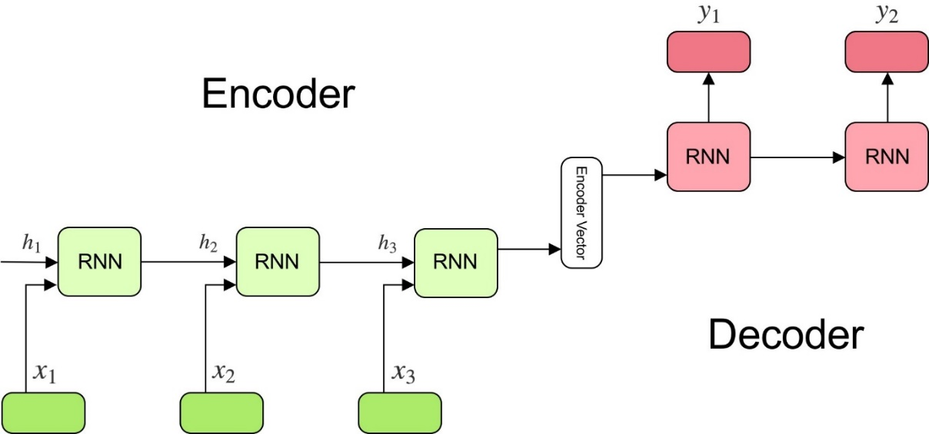
Sequence to Sequence Models
A model that aims to map a fixed-length input sequence to a fixed-length output sequence, where the lengths may differ.

Slide 34

Encoder
A stack of several recurrent units (LSTM or GRU cells for better performance) where each accepts a single element of the input sequence, collects information for that element and propagates it forward.
The input sequence is a collection of all words from the sentence. Each word is represented as x_i where i is the order of that word.
The hidden states h_i are computed using the formula:

Slide 35
Encoder Vector
This is the final hidden state produced from the encoder part of the model. It is calculated using the formula above.
This vector aims to encapsulate the information for all input elements in order to help the decoder make accurate predictions.
It acts as the initial hidden state of the decoder part of the model.

Slide 36


Decoder
A stack of several recurrent units where each predicts an output y_t at a time step t.
Each recurrent unit accepts a hidden state from the previous unit and produces and output as well as its own hidden state.
In the question-answering problem, the output sequence is a collection of all words from the answer. Each word is represented as y_i where i is the order of that word.
Any hidden state h_i is computed using the formula:

Slide 37
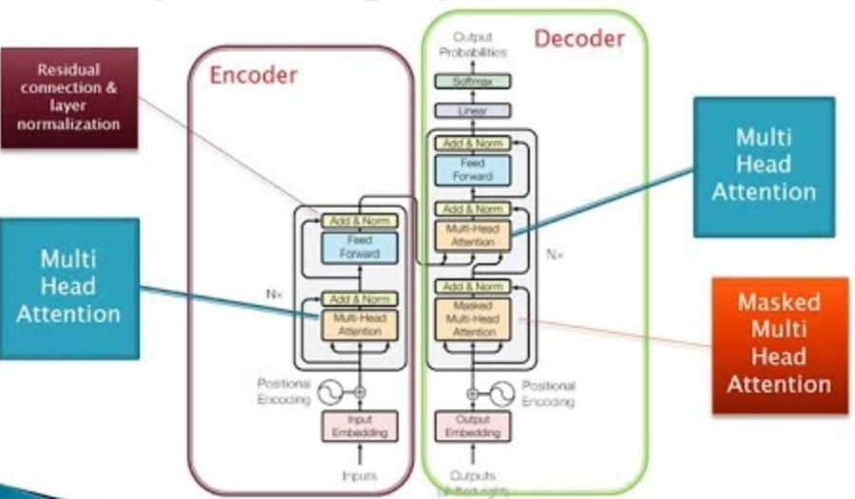
Transformer
This model attempts to solve the challenge of long term dependencies of LSTMs
Introduces an attention layer on each encoder and decoder to store a hidden state of each layer
The decoders do not only access the last encoder vector but can check a matching hidden state from all the encoders.
Computing between the layers is done in parallel. True parallel encoder decoder performance.

Slide 38
Attention
The main problem of the sequence to sequence model is the need to take in the entire contents of the source sequence into a fixed size vector.
If the text is longer, it is likely to lose some of the information in the text.
Attention layer removes this bottleneck by enabling the decoder to check back at the sequence of all the hidden states of the source encoders and then provide a weighted average as additional input to the decoder.
Therefore, the model selects the context that best fits the current decoder node as input.
Notes:
The decoders do not directly utilize the hidden states given by all encoders as input, but they have a way to choose the hidden state that best matches the current node. It does this by calculating the value score of each hidden state and using a softmax activation function over the scores, which amplifies the hidden state with the highest correlation and diminishes the less relevant hidden states. This scoring mechanism is done at each step of the decoders.

Slide 39
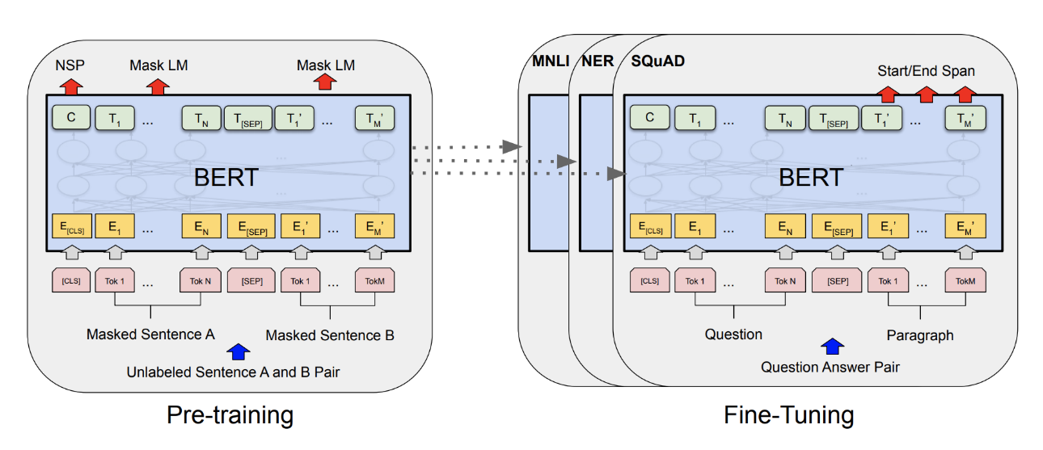
Bidirectional Encoder Representation from Transformer
It is based on Transformer architecture which is a sequence to sequence model based on Attention

Slide 40
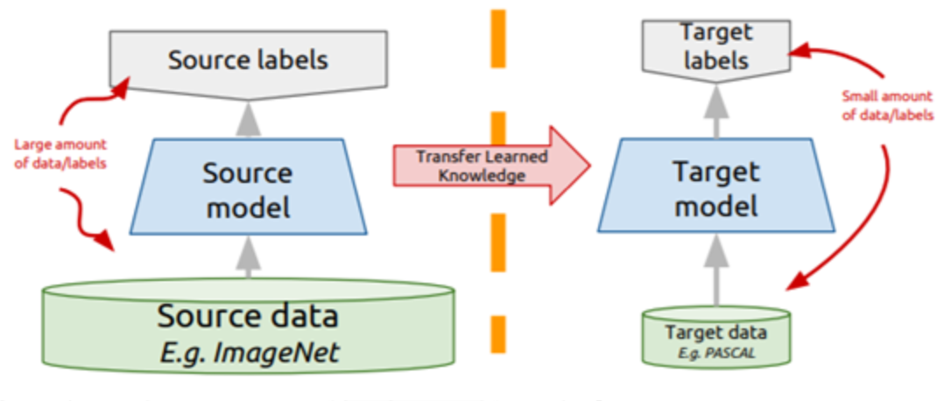
Transfer Learning in BERT
Has 2 stages: Pre-training and Fine-tuning
Pre-training
MLM – Masked tokens are predicted to generate a hidden vector which is fed into a softmax function to get a probability distribution of the predictions. Since context of the masked words is read from both left and right sides of each word, the MLM enables the training of the deep two-way Transformer to produce a bidirectional pre-trained model.
The Next Sentence Prediction (NSP) task is a training step during pre-training of BERT that provides for the model to learn about the relations between subsequent sentences in the data. It is done after the MLM training.
Fine-tuning: - Last training stage is to fine-tune with the specific task data
Notes:
BERT Model Input
Token embeddings which represent the word vector where the first word is preceded by CLS flag. The flag can be used for subsequent classification tasks or ignored for non-classification tasks.
Segment Embeddings which are used to distinguish between two sentences as sometimes the embedding could be a classification task with two input sentences.
Position Embeddings that encode word order. Below is a visual representation of the Embeddings:

Slide 41
Our Work

Slide 42
A DEEP NEURAL NETWORK MODEL FOR DETECTION OF URGENCY IN THE SHORT MESSAGE SERVICES (SMS)

Slide 43
Background Information
mHealth SMS interventions have gained popularity
Scaling such interventions is in much need to reach out to mass populations requiring health services
Main challenge with scaling is how to manage volumes of incoming messages
Response times
Streamlining staff to manageable levels
We investigate machine learning approaches to: -
Predict urgency for incoming SMS message to improve response times
Explore ways to provide retention of contextual meaning for meaningful classification and hence provide a “Triage Facility” for patient messages.

Slide 44
Statement of the Problem
mHealth setups involve volumes of incoming messages. These are read and responded to manually in most settings
Prone to delays, bias, misjudgement, misrepresentation.
Detecting urgency in text messages for the mHealth still remains a grey area in research
Understanding Engagement is key to the success of predicting urgency. Contextual representations a major challenge.
How computer based models can correctly represent natural language understanding from a mHealth perspective. Hence provide a “message triaging facility”

Slide 45
Main Objective
To develop a model that will detect and categorize text messages into an urgency scale based on the full context of patient engagement.

Slide 46
Specific Objectives
Examine word embedding algorithms in text representation for formulation of very rich representations from combined text messages of the same context and source.
1
Classify patient response messages on a scale of urgency from most urgent to least urgent based on patient engagement.
2
Demonstrate contextualized word embeddings provide a mechanistic approach for implementing natural language understanding algorithms.
3

Slide 47
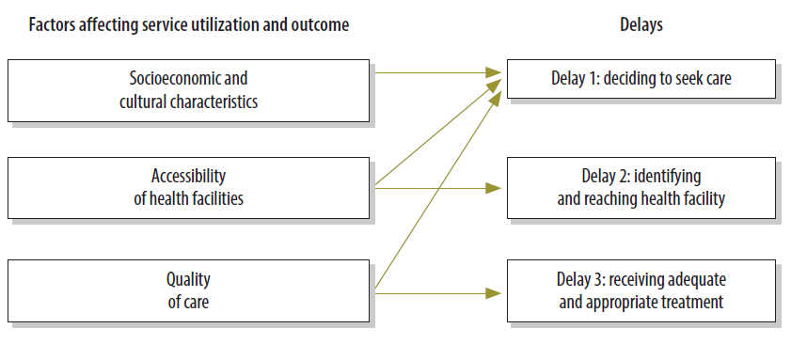
Justification
Delay 1: Provide a timely classification from the context of the correspondences to advice healthcare provider on the likelihood or urgency of the condition.
Delay 2: Topic modelling and classification can provide specific medical service catalogue area that the patient can be referred to.
Delay 3: Providing information that will be appropriate and accurate to lead to the right treatment.

Slide 48
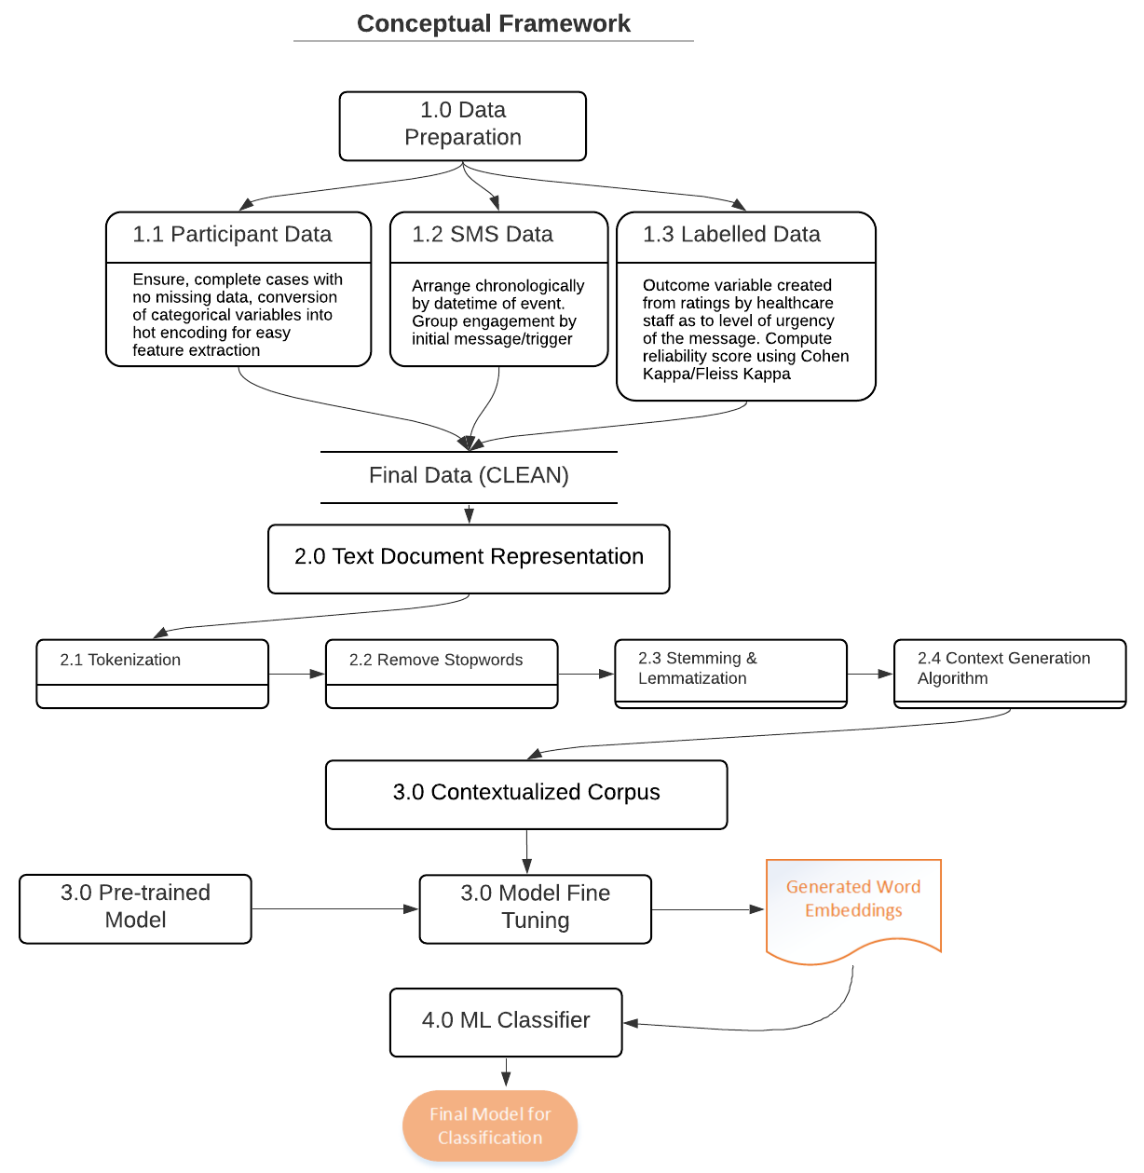

Slide 49
Study Design – mWACh Study
Mobile WACh:
Mobile Solutions for Women’s and Children’s Health (MW) that engages mothers using short message service (SMS) to increase demand for care, and has demonstrated promise for improving outcomes of both mothers and infants
Provides two-way semi-automated communication with a trained nurse
Mobile WACh NEO:
Communication Empowering Mothers and Newborns
Covers Peripartum Period (28 weeks EGA – 12 weeks postpartum)

Slide 50
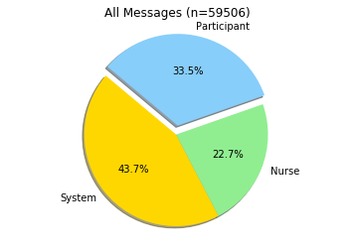
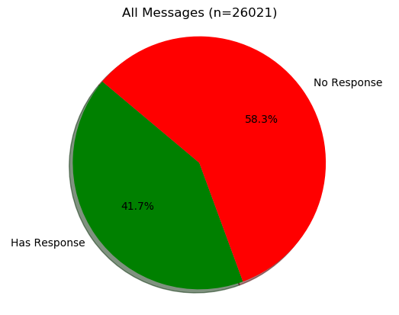
Data
System Messages

Slide 51
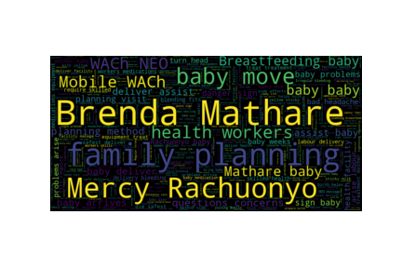
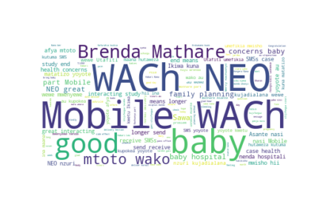
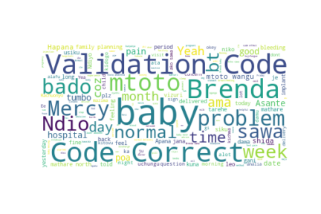
Words Frequencies (most used)
System Messages
Participant
Nurse

Slide 52
Descriptive Features used
Delivery status – Whether message was delivered to recipient
Past Response – If participant responded to their last message
Swahili – If message was sent in Swahili
Luo – If message was sent in luo language
Edd_wk – length of expected date of delivery
Study_wk – length of stay in the study
Native_language – whether message was sent in Swahili or Luo (1), or default which is english (0)

Slide 53
Results
 |  | Prediction Results
 |  | Model | Features | Accuracy Score | Receiver Operator Curve (AUC) | K-Fold accuracy Score | K-Fold Receiver Operator Curve (AUC)
Selected Descriptive Features | 1 | Logistic regression | edd_wk,study_wk,past_response,native_langauge,delivery_status,swahili,english,luo | 68.6 | 73.1 | 69.3 | 73.9
 | 2 | GB Classifier | edd_wk,study_wk,past_response,native_langauge,delivery_status,swahili,english,luo | 70.3 | 75.1 | 71.3 | 75.6
NLP Based Models with descriptive features | 3 | Logistic Regression on BoW | BoW | 66.6 | 70.7 | 66.9 | 71.1
 | 4 | Logistic Regression on BoW | BoW + edd_wk,study_wk,past_response,native_langauge,delivery_status,swahili,english,luo | 71.8 | 78.5 | 72.3 | 78.7
 | 5 | GB Classifier on BoW | BoW | 64.4 | 67.6 | 64.1 | 66.8
 | 6 | GB Classifier on BoW | BoW + edd_wk,study_wk,past_response,native_langauge,delivery_status,swahili,english,luo | 70.3 | 75.1 | 71.7 | 77.5
 | 7 | Logistic Regression on Bi-grams | Bi-grams only | 67.3 | 72.4 | 67.6 | 72.1
 | 7 | Logistic Regression on Bi-grams | Bi-grams + edd_wk,study_wk,past_response,native_langauge,delivery_status,swahili,english,luo | 72.3 | 78.5 | 72.5 | 78.8
 | 8 | GB Classifier on Bi-grams | Bigrams + edd_wk,study_wk,past_response,native_langauge,delivery_status,swahili,english,luo | 71.0 | 76.9 | 71.7 | 77.6
Advanced NLP model | 9 | Gensim doc2vec on GB classifier | Doc2Vec embeddings | 72.4 | 76.6 | 71.4 | 75.8

Slide 54
Some model Predictors
Descriptive Feature Predictors
NLP Predictors (top)
NLP Predictors (bottom)
brenda mercy | -1.49
joy huyu | -1.55
mama mary | -1.67
beatrice mercy | -1.67
mathare susan | -1.69
mathare judy | -1.71
mama fidel | -1.75
irene huyu | -1.75
quinter brenda | -1.75
rozy brenda | -2.14
sharon huyu | -2.15
mama maureen | -2.46
mama triza | -2.70
delivery_status | 1.9787
past_response | 1.3779
swahili | 0.0761
edd_wk | -0.007
study_wk | -0.0349
native_language | -0.30145
luo | -0.3776
features | coefficients
mama rose | 2.99
rozy huyu | 2.95
pam mercy | 2.13
leah | 2.06
precious brenda | 1.98
min fidel | 1.92
cynthia brenda | 1.85
sharon brenda | 1.85
mama loise | 1.81
grace brenda | 1.78
leah mae | 1.78
doreen | 1.71
doreen huyu | 1.71
emma brenda | 1.68
derick brenda | 1.64
nyabasi | 1.63
chemutai | 1.61
chemutai mercy | 1.61
linda | 1.61
esther brenda | 1.6
beatrice brenda | 1.59
joel | 1.58
mama joel | 1.57
NLP Non Predictors (middle)
mathare kagea | 0.00
mathare kareen | 0.00
mathare madam | 0.00
rachuonyo evelyne | 0.00
jacinta huyu | 0.00

Slide 55
Predicting a response (top)
response | ypred | Text
1 | 0.99 | Doreen, huyu ni Brenda kutoka kwa Mathare. Asante kuwa nasi kwa Mobile WACh NEO. Hii ndiyo SMS ya mwisho kutoka kwetu. Tafadhali hakikisha umekuja kutuona kwa ziara yako ya mwisho ya huu mradi! Unarudi clinic lini? Tafadhali tujulishe ili tupange uje utuone.
1 | 0.99 | Triza, huyu ni Brenda kutoka kwa Mathare. Asante kuwa nasi kwa Mobile WACh NEO. Hii ndiyo SMS ya mwisho kutoka kwetu. Tafadhali hakikisha umekuja kutuona kwa ziara yako ya mwisho ya huu mradi! Unarudi clinic lini? Tafadhali tujulishe ili tupange uje utuone.
1 | 0.99 | Hellen, huyu ni Brenda kutoka kwa Mathare. Asante kuwa nasi kwa Mobile WACh NEO. Hii ndiyo SMS ya mwisho kutoka kwetu. Tafadhali hakikisha umekuja kutuona kwa ziara yako ya mwisho ya huu mradi! Unarudi clinic lini? Tafadhali tujulishe ili tupange uje utuone.
1 | 0.99 | Mama Victor, huyu ni Brenda kutoka kwa Mathare. Asante kuwa nasi kwa Mobile WACh NEO. Hii ndiyo SMS ya mwisho kutoka kwetu. Tafadhali hakikisha umekuja kutuona kwa ziara yako ya mwisho ya huu mradi! Unarudi clinic lini? Tafadhali tujulishe ili tupange uje utuone.
1 | 0.99 | Brenda Achieng, huyu ni Brenda kutoka kwa Mathare. Asante kuwa nasi kwa Mobile WACh NEO. Hii ndiyo SMS ya mwisho kutoka kwetu. Tafadhali hakikisha umekuja kutuona kwa ziara yako ya mwisho ya huu mradi! Unarudi clinic lini? Tafadhali tujulishe ili tupange uje utuone.
1 | 0.99 | Mary, huyu ni Brenda kutoka kwa Mathare. Asante kuwa nasi kwa Mobile WACh NEO. Hii ndiyo SMS ya mwisho kutoka kwetu. Tafadhali hakikisha umekuja kutuona kwa ziara yako ya mwisho ya huu mradi! Unarudi clinic lini? Tafadhali tujulishe ili tupange uje utuone.
1 | 0.99 | Petronilla, huyu ni Brenda kutoka kwa Mathare. Asante kuwa nasi kwa Mobile WACh NEO. Hii ndiyo SMS ya mwisho kutoka kwetu. Tafadhali hakikisha umekuja kutuona kwa ziara yako ya mwisho ya huu mradi! Unarudi clinic lini? Tafadhali tujulishe ili tupange uje utuone.
1 | 0.99 | Agnes, huyu ni Brenda kutoka kwa Mathare. Asante kuwa nasi kwa Mobile WACh NEO. Hii ndiyo SMS ya mwisho kutoka kwetu. Tafadhali hakikisha umekuja kutuona kwa ziara yako ya mwisho ya huu mradi! Unarudi clinic lini? Tafadhali tujulishe ili tupange uje utuone.

Slide 56
Predicting no response (bottom)
response | ypred | Text
0 | 0.01161 | Min Edwin, mae en Mercy mawuok Rachuonyo. Ejumbe mabiro wabiro oro ni SMS mondo okonyi ng'ado rieko e yore mag komo nyuol. Komo nyuol ber ne ngimani. Be ipango mako ich moro endalo mabiro?
0 | 0.01091 | Mama Mutheu, huyu ni Brenda kutoka Mathare. Mama Mutheu huyu niBrenda kutokaMathareUmejifunguwa ? Tuko hapa kwa ajili yako. Tafadhali tujulishe mara tu unapojifunguwa ili tuweze kukusaidia baada ya mtoto kuzaliwa.
1 | 0.01004 | Evelyne, mae en Mercy mawuok Rachuonyo.Evelyne mae Mercy koa Rachuonyo. Pend nyathi biro tuo bang juma achiel kata bang jumbe adek.onyalo nyuer matin mak mana ka ineno ka ochuer kendo odum to I kel nyatni e sopital ,bende ineno ka kanyo chango maber?
0 | 0.00879 | Min Leon, mae en Mercy mawuok Rachuonyo. Yore mag komo nyuol tio mopogore ne ji mopogore. Isebedoga kitio gi yore mage mag komo nyuol? To be nihero gi? To be diher mar tio kodgi kendo?
0 | 0.0067 | Min Mum, mae en Mercy mawuok Rachuonyo. Nyithindo dhi ga e losruok maduong dichiel odiochieng' lakini moko nyalo losore oko maduong mokalo dichiel. Ka nyathini dhi oko maduong matinne didek e juma to nyalo bedo ni iye okuot onego konye. Be ingi wach moro amora?
0 | 0.00648 | Min Lucy, mae en Mercy mawuok Rachuonyo. Yuak mar nyathi nyalo kelo paro ne jonyuol. Ka nyathini yuak ahinya moloyo saboro kata godhiambo nyalo bedo ni iye rame. Tem ikete konindo auma e bamni ti rudhone ne toke kata inyalo kete badi kawie ong'io piny ti swuoye. Nyiswa kineno magi kendo kidwaro puonj moko.
0 | 0.00604 | Min Edwin, mae en Mercy mawuok Rachuonyo. Nyathini nitie kod kuonde ariyo mayom ewiye kama chogo pok obedo motegno.ma timore mondo ne nyathi owuog maber kar nyuol. Kadipo ni wi nyathi odonjo iye to ma nyalo bedo ranyisi mar koso pii edend nyathi,kendo onyalo okuot iye ka nyathi ywak. Onego obed kare ka nyathi oweyo ywak ,kapo ni nyathini ni kod ranyisigi to lim osiptal kata nas e klinik,bende ise neno gigi?
0 | 0.00576 | Min Mum, mae en Mercy mawuok Rachuonyo. En kare komo nyuol. par matut kapok idhi e klinik. Nitiere yore mathoth kendo yiero en mari. okwayi mondo iwuo gi nas ewi yore mag komo nyuol e limbe mabiro. Be wanyalo konyi e ng'ado paro?
1 | 0.00548 | Mama Jack, huyu ni Brenda kutoka Mathare. Mama Jack huyu ni Brenda kutoka Mathare. Umejifunguwa? Tuko hapa kwa ajili yako. Tafadhali tujulishe mara tu unapojifunguwa ili tuweze kukusaidia baada ya mtoto kuzaliwa.
0 | 0.00373 | Min Edwin, mae en Mercy mawuok Rachuonyo. Implant en mar komo nyuol. Ikete e badi kendo otiyo maber kuom igni adek. Implant inyalo gol esaa moro amora! . Penj kuom implant esa ma ibiro elimbeni mar komo nyuol. Bende iniere gi penjo moro amora kuom implant?

Slide 57
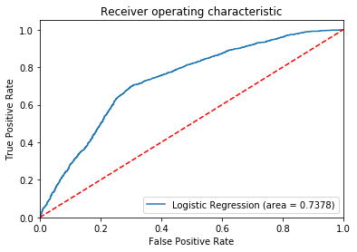
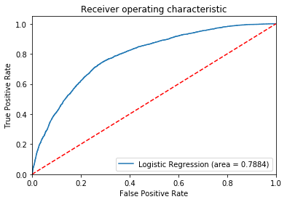
Discussion…
1. Prediction power – Increased prediction power when using NLP models as part of feature vectors
Logistic regression on features only.
Logistic regression using Bi-grams and selected features
From the above figures, we see an increment of more than 5% when using an NLP method alongside selected features

Slide 58

Discussion…
2. Gradient Boosting Machines were also noted to increase prediction power compared to normal
logistic regression models as shown below.
Logistic regression on select features
GB Classifier on same features
The charts above show an increase in 2% on prediction power when using Gradient Boosting Classifiers compared to normal logistic regression. However, this is not always the case as sometimes using GB classifiers results in a lower prediction rate as seen in the table of results above.

Slide 59
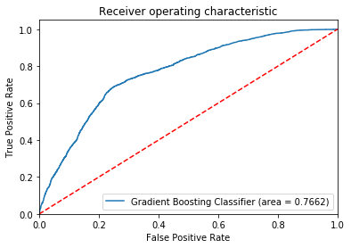
NLP for predicting engagements
2. Can we use messages to predict an engagement?
Using Doc2Vec only, without any additional feature vectors delivered a 76% prediction roc_auc score and 71% accuracy score.

Slide 60
Work Plan
Document
Document labelled dataset using human domain experts
Validate inter rater agreement using Fleiss Kappa score
Generate
Generate word embeddings using BERT – Fine tuning on target dataset
Perform
Perform experiments using word embeddings only, then with descriptive features
Repeat
Repeat experiments with GPT2, GPT3.

Slide 61
Acknowledgements…
Dr. Abraham Flaxman – IHME
Dr. Keshet Ronen, Jenn Unger & all mWACH Family
Dr. Tobias Mwalili – JKUAT
Dr. Lawrence Nderu - JKUAT
Prof. Judd Walson – UW Global Health
Prof. Jay Berkely – Kemri-welcome Trust

Slide 62
END….

